Slide 1
2014 Bond Program Update
July 29, 2016

Slide 2
Facilities
Fine Arts
Safety, Security and Technology
Transportation

Slide 3
Bond Program Timeline
Defined Program Timeline
  Major phases of the program (Phase 1 – 5)
  Major phases of the project (design, procurement, construction, etc.)

Slide 4
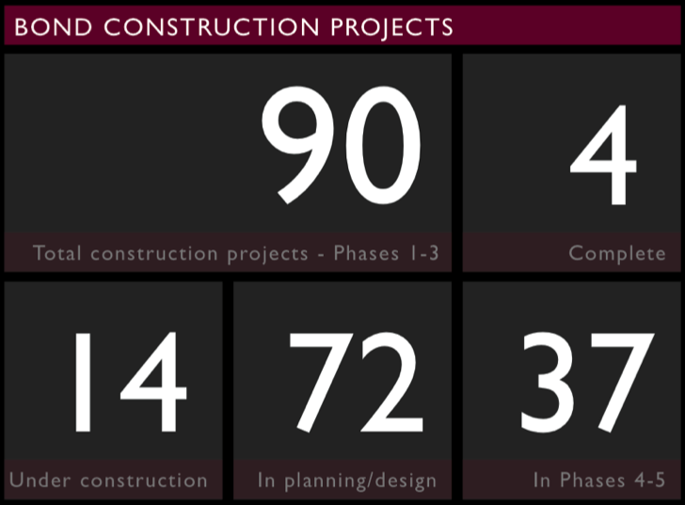
Facilities
CURRENT CONSTRUCTION
^{Arlington High School MAC}
^{Boles Junior High Special Ed}
^{Bowie High School MAC}
^{Career/Tech Center}
^{Corey Academy}
^{Jones Academy}
^{Lamar High School MAC}
^{Martin High School MAC}
^{McNutt Elementary}
^{Peach Elementary}
^{Ousley Junior High}
^{Sam Houston High School MAC}
^{Seguin High School MAC}
^{Workman Junior High}
Notes:
We are working on Phases I, II & III currently. The projects listed here are phase I projects. All of these except the Boles Special Ed addition, CTC, & Jones will be ready for use this fall.
Boles Special Ed will be completed next Spring
CTC & Jones will be completed next summer

Slide 5
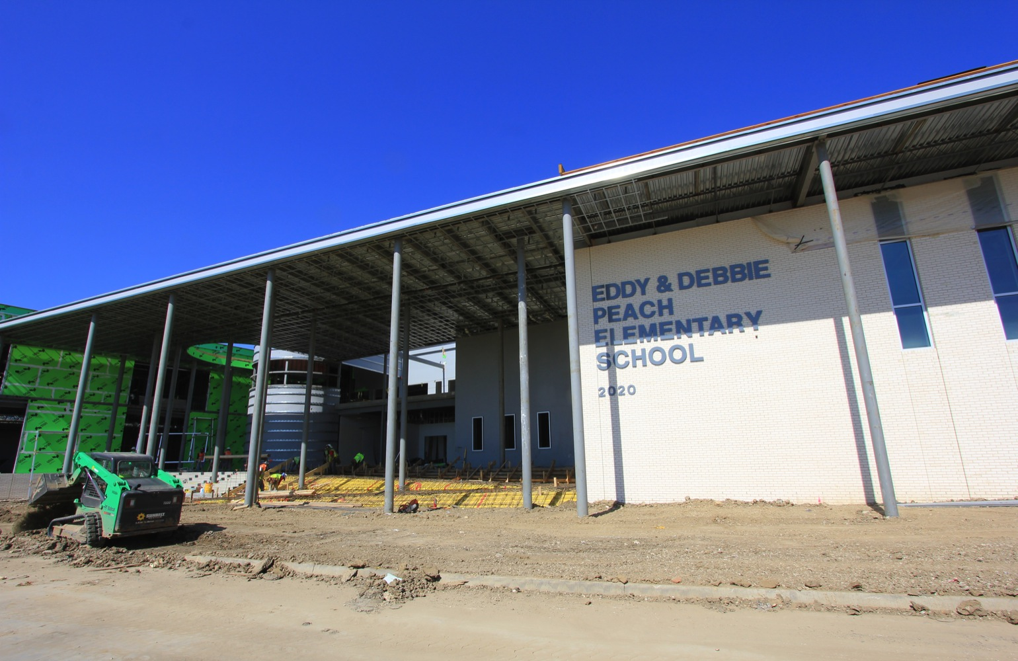
Facilities – construction highlights
Multi-Purpose Activity Centers at each traditional high school campus will open in fall 2016
Peach Elementary
Notes:
Both Peach & McNutt are running down to the wire on their construction
Teachers will move into their classrooms on Saturday and Sunday before school starts on Monday, August 22nd.
Peach ran into delays due to permitting issues, buried concrete that had to be removed, rain, and site utility issues.

Slide 6
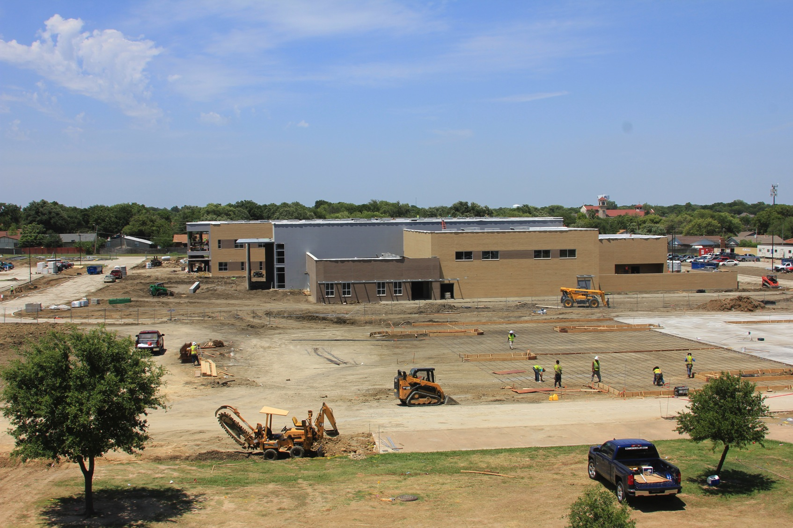
Facilities – construction highlights
Multi-Purpose Activity Centers at each traditional high school campus will open in fall 2016
McNutt Elementary
Notes:
McNutt ran into similar permitting issues and rain delays. We also were delayed several weeks while subcontractors tried to drill thru rock shale. Two drilling rigs broke before the contractor got a rig that was able to drill thru the rock. Once they got thru the rock, they hit water, and we had to case the piers and use hydraulic concrete.
The second floor of one classroom wing will not be ready when school opens. The building has a capacity of 900 students. We expect about 650 kids at McNutt when school opens, so we plan to manage within the spaces available to us. The 2nd floor area should be finished approximately 4 weeks after school begins.

Slide 7
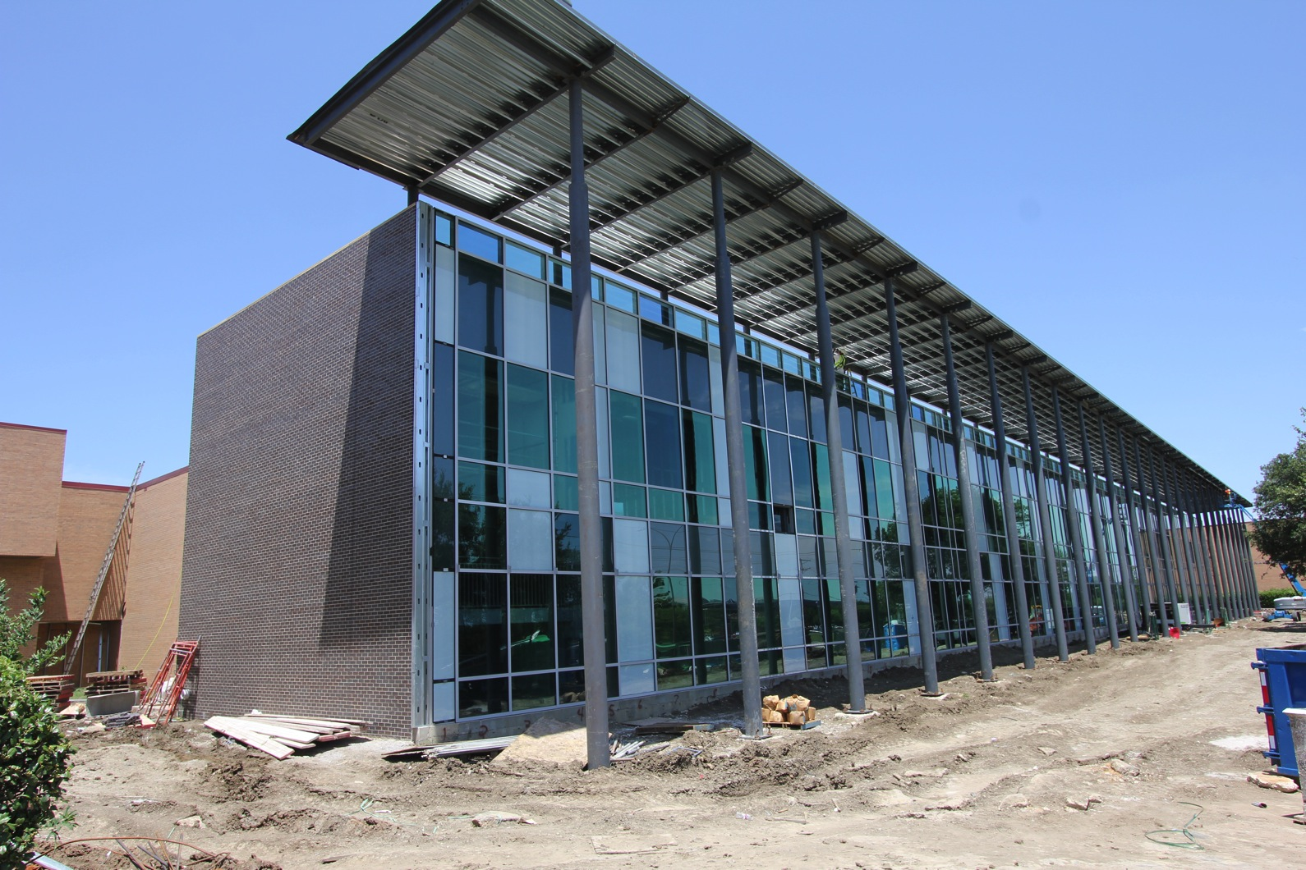
Facilities – construction highlights
Multi-Purpose Activity Centers at each traditional high school campus will open in fall 2016
Workman Junior High
Notes:
This is the classroom addition at Workman. It has completely transformed the look of this building from Arbrook. Besides the classroom addition, we are creating a new entrance and administrative office suite on the north side of the building, and deficiency work is taking place throughout the building. The deficiency work did not start until school let out last June. The new entrance and the deficiency work will come down to the wire.

Slide 8
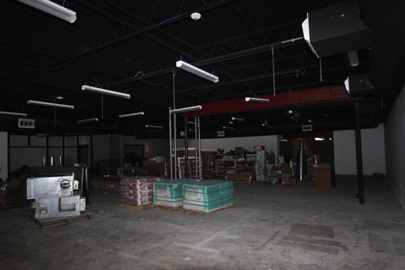
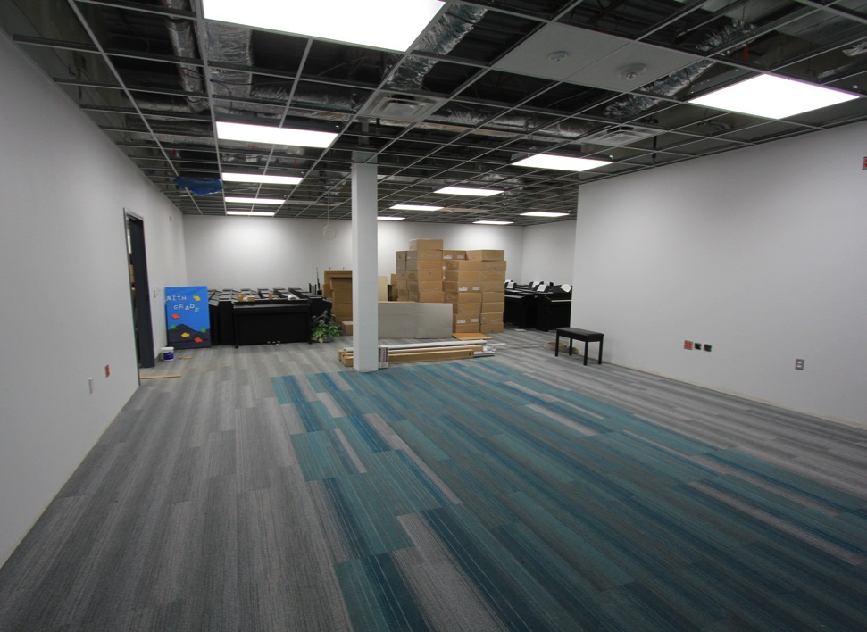
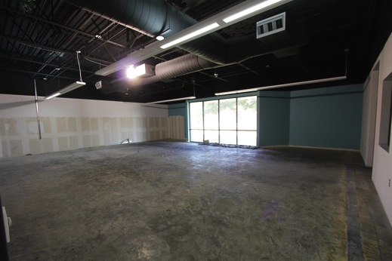
Facilities – construction highlights
Drama room (black box)
Dance room
Piano lab
Corey Academy

Slide 9
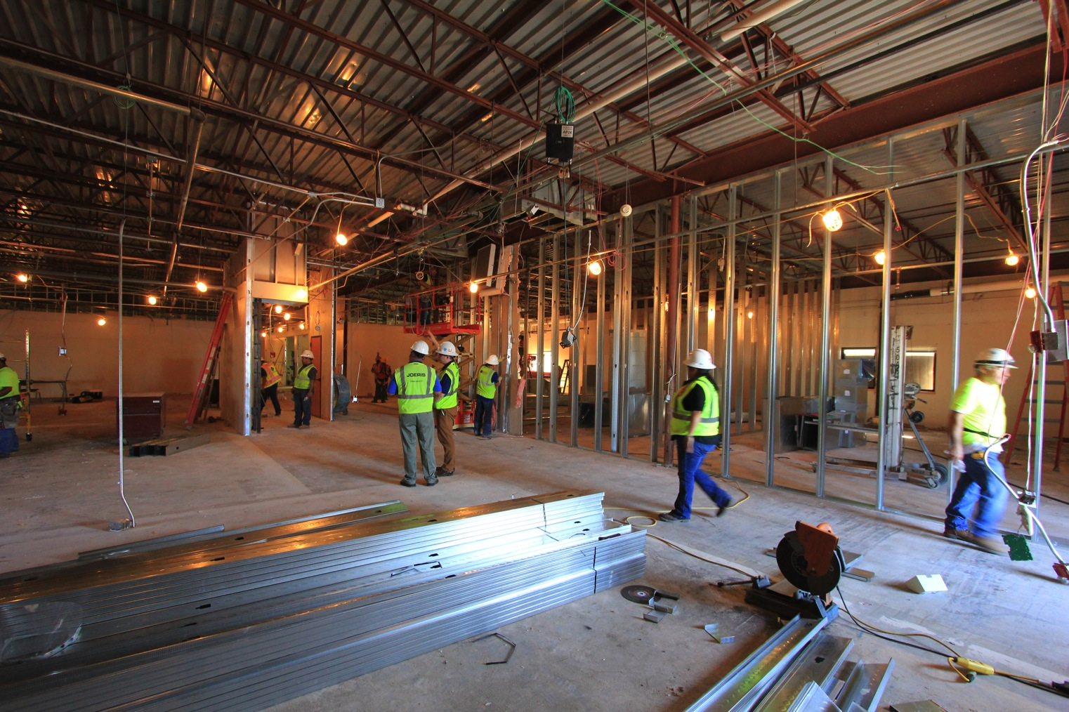
Facilities – construction highlights
Multi-Purpose Activity Centers at each traditional high school campus will open in fall 2016
Jones Academy – Music rooms

Slide 10
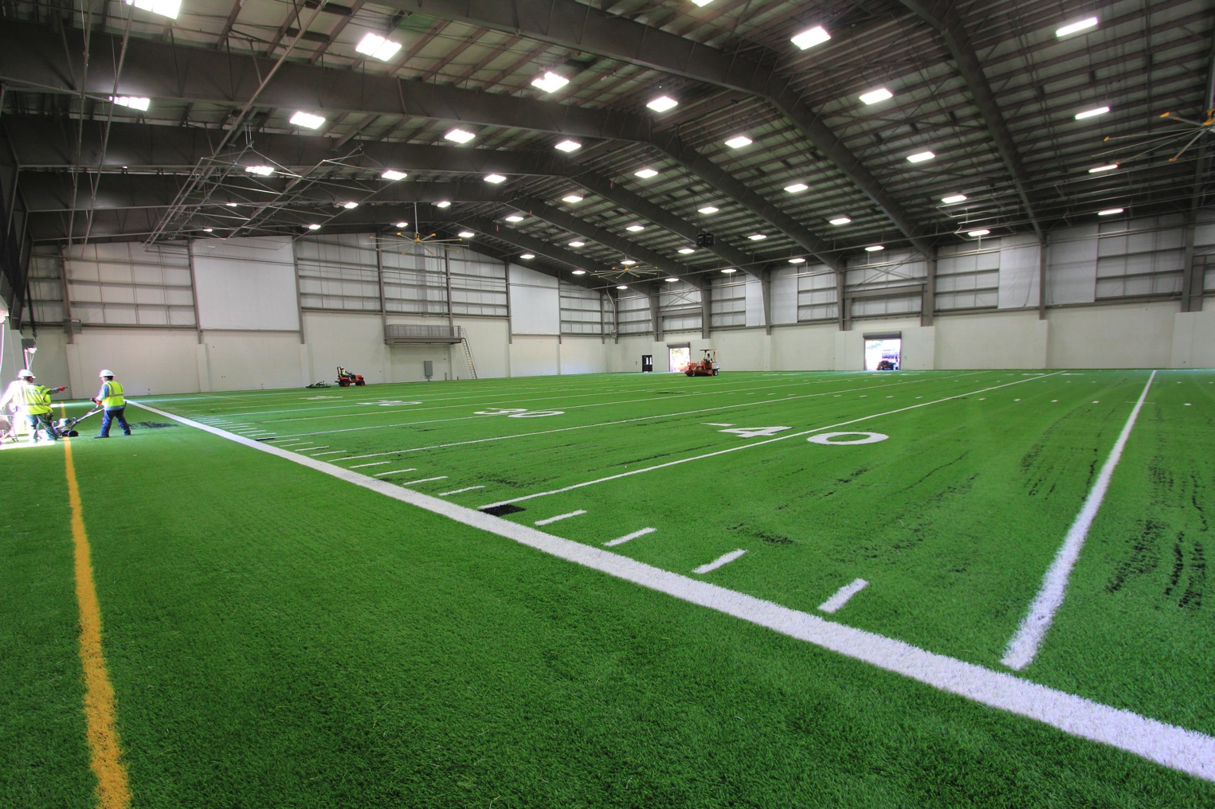
Facilities – construction highlights
Multi-Purpose Activity Centers at each traditional high school campus will open in fall 2016
AHS Multi-purpose Activity Center
Notes:
5 of the 6 multi-purpose activity centers will be complete by 8/31/16. Bowie’s MAC will be complete by 9/30/16.
The MACs each have a 60-yard turf field, weight room, training room, locker rooms, team meeting room, storage and coaches offices

Slide 11
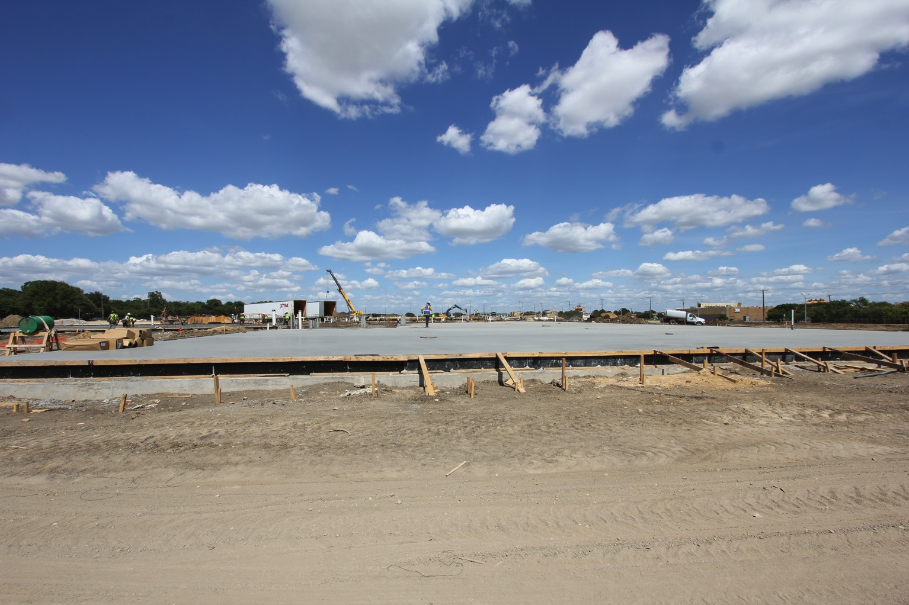
Facilities – construction highlights
Career and Technical Center
Notes:
Foundation work for the CTC is underway. Construction will be complete next July.

Slide 12
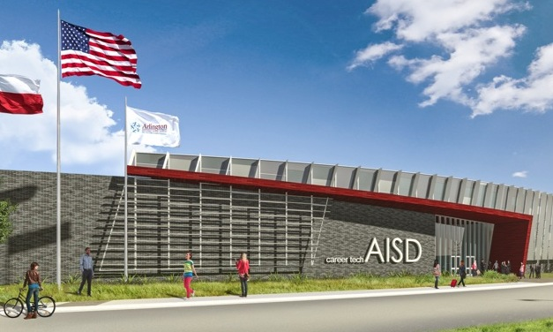
Facilities
PHASE 2 PROJECTS
Ag Science Center
Anderson*
Arlington
Ashworth*
Bebensee
Beckham*
Blanton*
Bryant*
Burgin*
Crouch
Crow*
Ditto*
Duff
Ellis
Farrell
Fitzgerald
Foster
Kooken*
Hale*
Knox
Larson*
Little
Martin
Miller
Moore
Morton
Nichols
Pearcy*
Remynse*
Sam Houston
Sherrod
South Davis
Starrett
Thornton
Turning Point JH
West*
Williams
Wood
Design work is at or near completion, construction is scheduled to begin by October
* STEM Labs, Strings Room, Security Vestibule
Notes:
GMPs for Ellis, Starrett & PDC are on the August 4th Board meeting agenda

Slide 13
Facilities
SAM HOUSTON HIGH SCHOOL

Slide 14
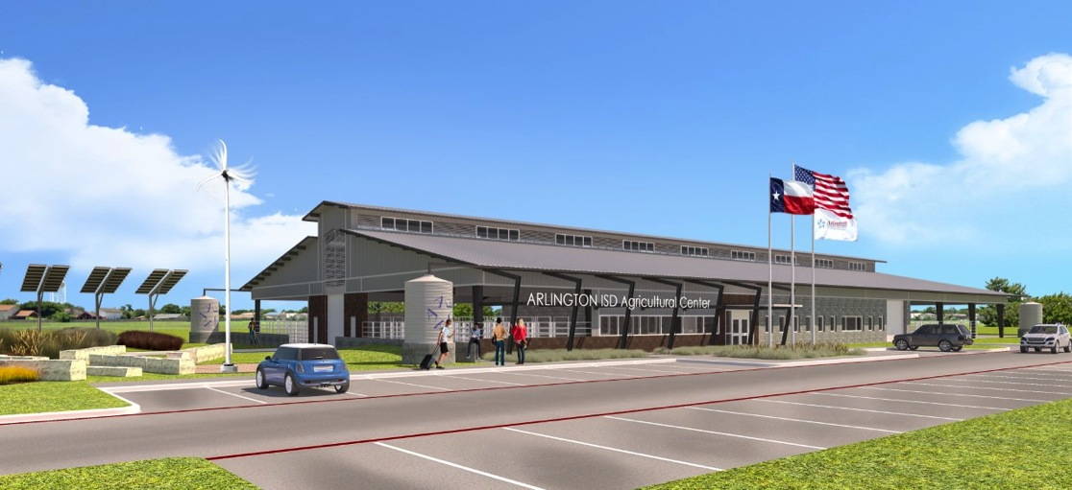
Facilities
AGRICULTURAL SCIENCE CENTER

Slide 15
Facilities
PHASE 3 PROJECTS
Design work is underway.
Construction is scheduled to begin in spring/summer 2017.
Amos
Atherton
Bailey*
Barnett*
Berry
Boles*
Butler
Carter*
Dunn
Goodman
Gunn
Gunn*
Hill
Johns
Key
Nichols*
Pope
Rankin
Roark
Seguin
Shackelford*
Short
Speer
Swift
Young*
Webb
Webb (kitchen)
Wimbish
* Track and sports lighting

Slide 16
Fine Arts
YEAR TWO MUSIC CAPITAL
New instruments and equipment ordered for summer delivery
New uniforms ordered
  Junior high band, choir and orchestra
  Lamar band
Total fine arts bond expenditures to date: $1,826,660
  On order: $628,331
200% increase since before the bond
Total Spent to Date: $1,826,660
On Order: $628,331
FINE ARTS PARTICPATION
Secondary instrumental music participation up 16% from 2014-15 to 2015-16
FINE ARTS EXPENDITURES
New instruments and equipment ordered for summer delivery
New uniforms ordered
  Junior high band, choir and orchestra
  Lamar band

Slide 17
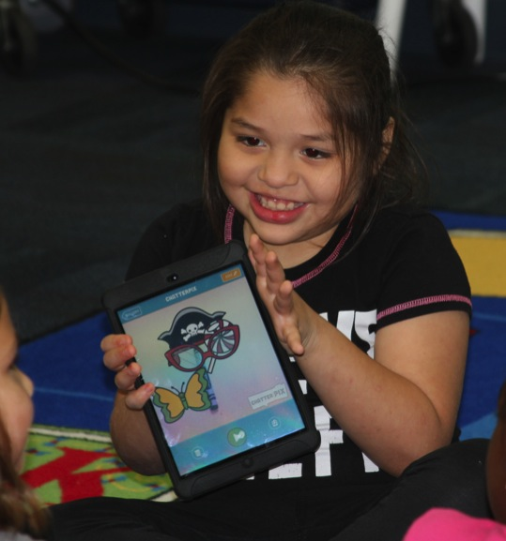
Security/Technology
CLASSROOM TECHNOLOGY STANDARDS
A/V Standard
  - 29/73 schools complete
Teacher Standard
  - 41/73 schools complete
Student Standard
  - 44/73 schools complete for
  Chromebooks
  - iPads for K-2 will start
  rolling out in fall
  (except Patrick & Little)
http://tinyurl.com/technologybond

Slide 18

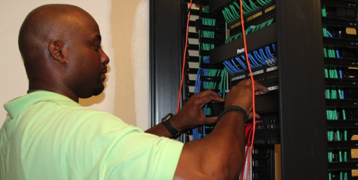
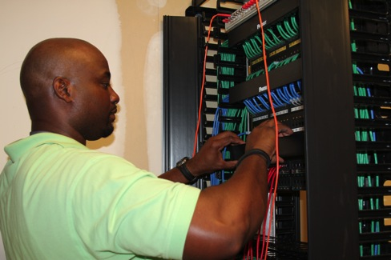
Security/Technolgoy
A/V Standard
  - 36/73 schools complete
Teacher Standard
  - 44/73 schools complete
Student Standard
  - 33/73 schools complete
DISTRICT BANDWIDTH
Now 9 Gb (Up 200% since before the bond)
200% increase since before the bond
WIRELESS UPGRADES
Network
18 campuses completed
Pick back up 2017-18
Wireless (1 AP per Classroom)
19 scheduled for 2016-17
Standard will be met
18 campuses completed so far

Slide 19

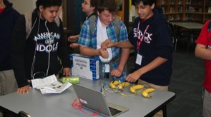
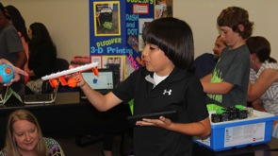
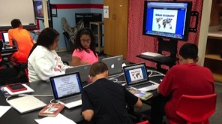
Security/Technolgoy
Now 9 Gb (Up 200% since before the bond)
TRANSFORMATION GRANT INIATIVE (TI GRANT)
Over $2.2 million awarded to date
74 grants awarded
Funds Allocated: $1 million per year ($5 million over 5 years)
TI Grant website:
http://tinyurl.com/tigrant
200% increase since before the bond
Grant Award History
2013-14: 12 grants ($374,650)
2014-15: 28 grants ($987,950)
2015-16: 34 grants ($916,364)

Slide 20
Security/Technolgoy
Now 9 Gb (Up 200% since before the bond)
TRANSFORMATION GRANT INIATIVE (TI GRANT)
TI Grant Timeline for 2016-17
Application process opens: July 19
**ALREADY OPEN!**
Grant Workshop Session 1: Aug. 29
Grant Workshop Session 2: Sept. 1
Planning Worksheet Due to ITS: Sept. 12
Proposal Window Closes: Sept. 19
200% increase since before the bond
*Register for Grant workshop sessions in Eduphoria under Instructional Technology

Slide 21

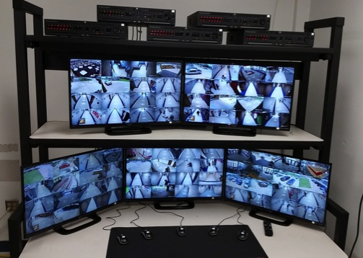
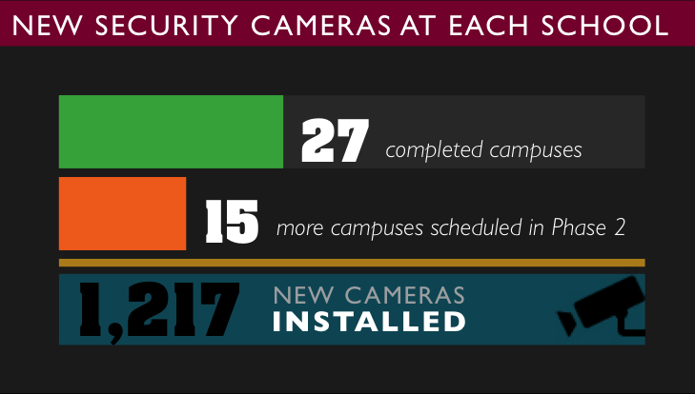
Security/Technolgoy
A/V Standard
  - 36/73 schools complete
Teacher Standard
  - 44/73 schools complete
Student Standard
  - 33/73 schools complete
SECURITY CAMERAS
27 completed campuses
15 more scheduled
in Phase 2
1,217 new cameras
installed so far
200% increase since before the bond
WIRELESS UPGRADES

Slide 22

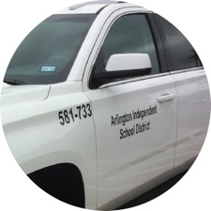
Transportation
A/V Standard
  - 36/73 schools complete
Teacher Standard
  - 44/73 schools complete
Student Standard
  - 33/73 schools complete
Now 9 Gb (Up 200% since before the bond)
SCHOOL BUSES
59 new buses so far
Zonar installed on all buses
19 will be purchased in 2016-17
200% increase since before the bond
WHITE FLEET
74 new service vehicles so far
25 will be purchased in 2016-17

Slide 23
Other Significant Activities in 2016-17
Select architects for Phase 4 projects
Instructional Programming
  Fine arts and dual language academies
  Career/Tech Center
Operations planning for Career/Tech Center
Staffing of Career/Tech Center
Select site for Fine Arts Center

Slide 24
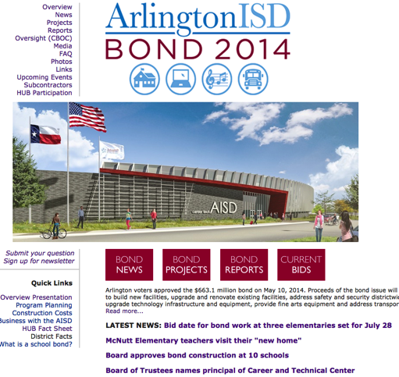


Want more information?
Visit
www.aisd.net/bond

Slide 25


Slide 26
Website Redesign
What will this process include?
Establish website committee
Development of district/department/campus standards and guidelines for writing, designing, and developing content
Creation of training materials and rollout plan
Timeline?
Starting fall 2016 until complete
Why?
To improve overall user experience
Provide consistency for all stakeholders to consume content
Ensure alignment with digital guidelines and requirements across all sites
New content management system will be much more intuitive, reliable, scalable and compliant

Slide 27

Web Accessibility
What is web accessibility?
The creation of digital resources on the web that everyone can use.
Who and what does this apply to?
ALL users that are creating and/or posting content online are required to adhere to federal guidelines and district standards. This ALSO includes any third party sites that the district links to and/or uses (e.g. Canvas, Google Apps, etc.).
Why is this important?
IT’S THE LAW! Per the Americans with Disability Act (ADA), any content created and/or posted online must be done with “Universal Design” in mind.
https://www.lynda.com/WordPress-tutorials/What-web-accessibility/374185/421829-4.html

Slide 28

Web Accessibility
What is Universal Design?
Creating pathways for individuals to learn, communicate, and share via information technology, regardless of their individual learning and processing styles, or physical characteristics.

Slide 29
Web Accessibility
Small Sampling of Potential Universal Design Elements:
Alternative Text: in conjunction with pictures/images to provide a textual alternative to non-text content.
Caption and/or provide transcripts for media: videos and live audio must have captions and transcript. Transcript may be sufficient for archived audio.
Non-HTML content: documents such as PDF files, Word documents, PowerPoint presentations must be as accessible as possible.
Color: low contrast between foreground (e.g. text) and background (e.g. images) elements are lost. Also, don’t use color alone to convey information (e.g. “the red line on the graph represents…”)

Slide 30

Copyright
What is copyright?
A form of protection given to the authors or creators of “original” work.
If I want to use something that was created by someone else do I have to get permission to use that material?
For the most part...yes…but there are some exceptions and a set of rules that should be followed.

Slide 31
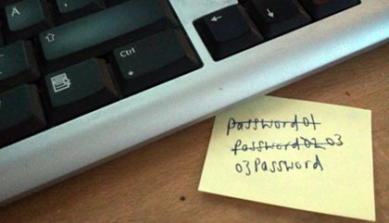
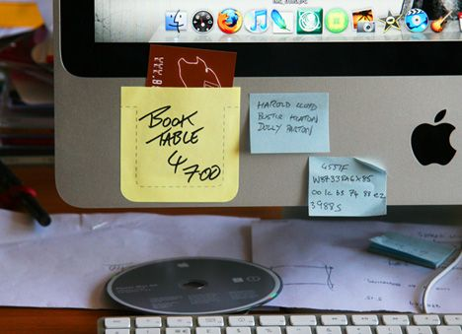
Single Sign-On
Network Password Requirements for 2016-17 School Year:
Grades PK, KG and 1 will keep same password all year (Aisd1234). This password will be changed prior to August 22.
Grades 2 through 12 initial password (Aisd1234) will also be changed prior to August 22 but each student will be required to change it through Rapid ID the first time they log in to the network.
Starting October 1, all employee passwords will expire every 90 days.
**Rapid ID Instructions will be emailed out in next weeks green bag to all staff.
Why are we doing this?
To ensure the security of your network account as we continue to integrate more systems together to make them easier to access.

Slide 32

Things to Remember!
myTrack is down for maintenance until first day of school for Teachers (August 22)
Review district assessment calendar for Technology Learning.com assessment window for 5th and 8th grade.
BrightBytes Technology survey for students/staff/parents will take place over month of November.
“Registration-In-A-Box” info for student registration was sent out to campus green bags on Wednesday, July 20.
ID software training for secondary schools:
  Next Wednesday and Thursday (Aug. 3 & 4) in AISD boardroom.
  Send at least one (1) person if you are taking pictures or print badges at registration.

Slide 33
Questions?

