Slide 1
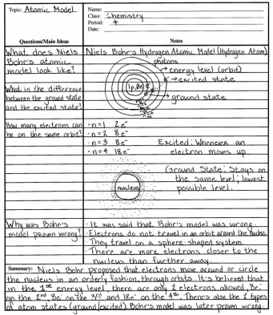
Cornell Note-Taking
Ms. Dowell
Notes:
Introduce students to Cornell Notes.
Relay that note-taking is a cornerstone of a GREAT student and more specifically a successful AVID student

Slide 2
Some Basics
Advantages
  Method for mastering information
  Efficient
  Sequential
Materials
  Cornell note paper
  Basic loose-leaf paper
Notes:
Discuss the Advantages of Cornell Notes
Let them know if they run out/don’t have C Note paper they can draw a 2 ½ inch line

Slide 3
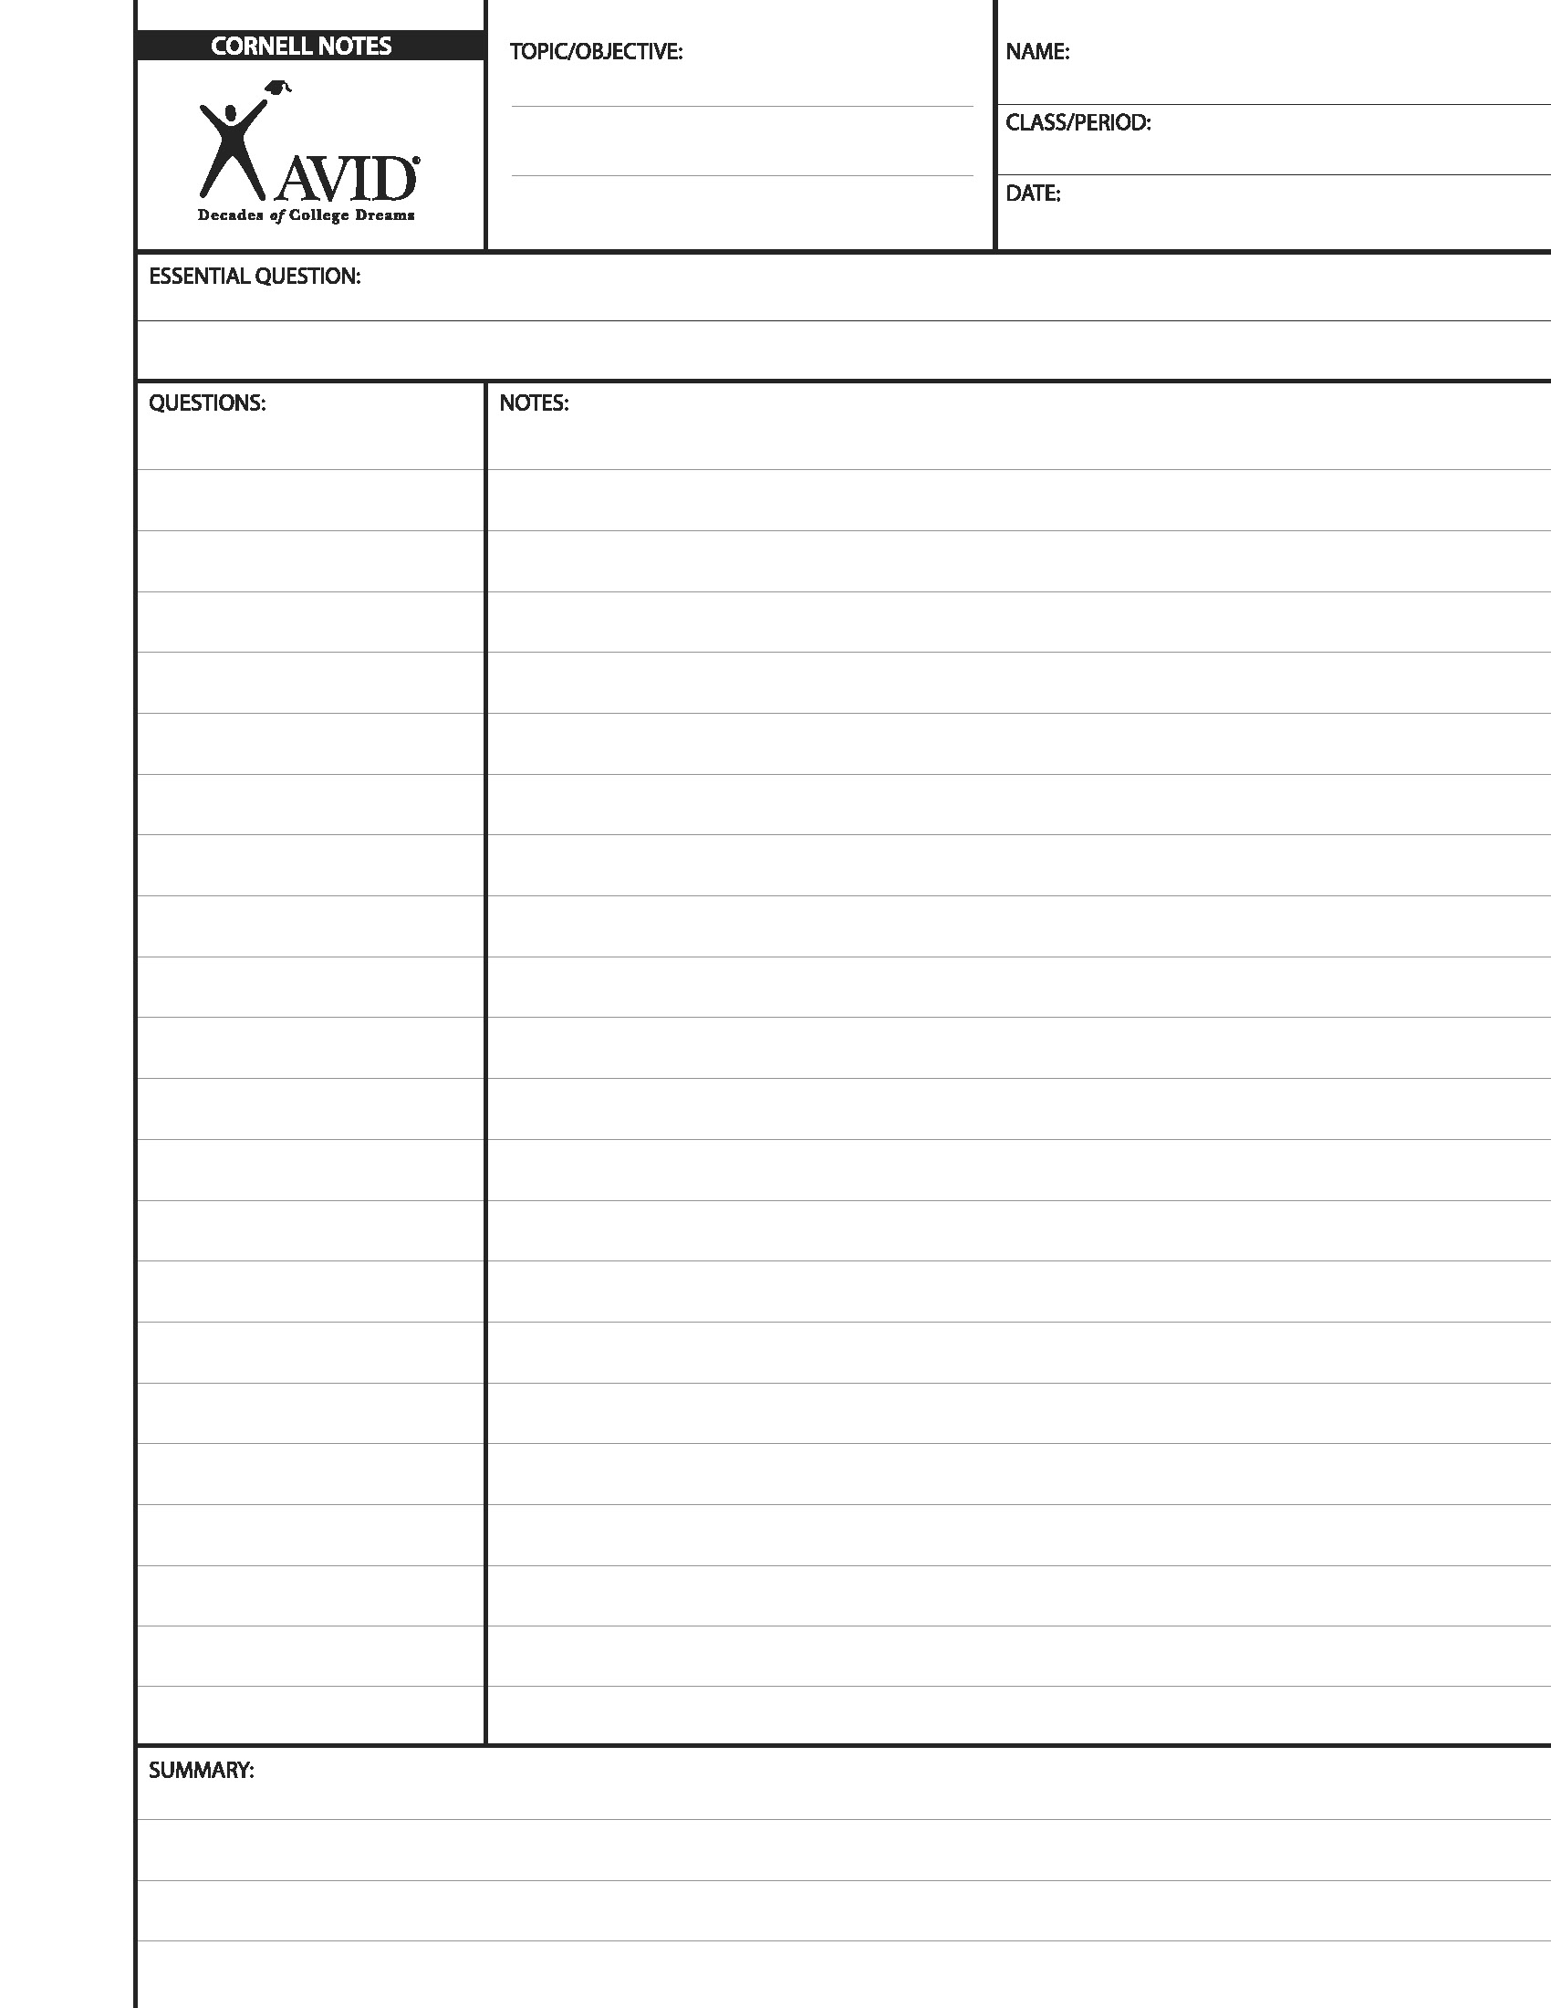

C-Note Paper Samples

Slide 4
Let’s Practice…
Notes:
Tell students they should begin taking notes now!

Slide 5
Heading…
Learning to
Take Cornell Notes
Name
AVID/ Per.
September
How are taking Cornell Notes different from how I have taken Notes
in the past?
Notes:
Have students fill out the heading (Topic, Name, and Essential Question)
Make sure that students Fill out this part in PEN!

Slide 6
During the Lecture
During Lecture
Write
In This
Section Only
Notes:
During a lecture they record their information on the RIGHT Side ONLY
Tell them to ignore the Questions and summary section until the lecture is over

Slide 7
Why Take Cornell Notes?
Help you work on assignments and study for tests outside of class
Stimulates Critical Thinking skills
Helps organize and process information
Help you recall information and use your notes multiple times

Slide 8
First & Last Name
Class Title
Period
Date
Topic
Essential Question
Questions,
Subtitles,
Headings,
Etc.
Class Notes
2 1/2”
3 to 4 sentence summary across the bottom of the last page of the day’s notes, which answers the Essential Question
Notes:
Tell Students To fill out the heading before the lesson begins
Make sure they have the line down the left side
Take Notes on the right side (ONLY) during the lecture
When the teacher is done, they should go back to write Questions on the left
That night they should summarize learning

Slide 9
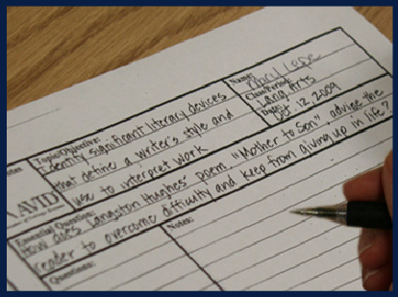
Before the Lecture Fill in Heading
Notes:
Here is an example of a properly filled out heading:
Name, Class, Period, and date (In PEN)
Topic of the Notes for the day
Essential Question (Is a question that captures the point of the lesson)

Slide 10
When there is no Essential Questions
Standard/Objective (ELA) | 3.6-Identify significant literary devices (e.g., metaphor, symbolism, dialect, irony) that define a writer’s style.
Essential Question | How do literary devices such as metaphor, symbolism, dialect, and irony define the writer’s style?
Standard/Objective (Math) | Alg. 9.0- Students use substitution to solve a system of two linear equations in two variables algebraically.
Essential Question | How is a system of two linear equations solved by substitution?
Standard/Objective (SS) | 10.5.2- Understand the role of Appeasement, nonintervention (isolationism), and the domestic distractions in Europe and the United States prior to the outbreak of World War II.
Essential Question | Why is Appeasement a contributing factor to the start of World War II?
Topic (Science) | Diffusion and Osmosis
Essential Question | • What is the process of diffusion and osmosis in a membrane system?
Notes:
If a teacher does not give the students an Essential Question:
Have them take the daily standard and turn it into a question.
Discuss how this can be done in all classes

Slide 11
During the Lecture
From “lecture”, text, video, projects, etc.
Paraphrasing
Skip lines between ideas
Abbreviate
Use phrases
Use bullets/lists
Recognize cues from teachers
Use outline style, diagrams, pictures, graphs
Notes:
Point out when they take notes and some of the skills that will help them be more effective
From “lecture”, text, video, projects, etc.
Paraphrasing
Skip lines between ideas
Abbreviate
Use phrases
Use bullets/lists
Recognize cues from teachers
Use outline style, diagrams, pictures, graphs

Slide 12
After the Lesson…
Highlight important information
Cross out non-essential information
Star (*) any information that might show up on a test/quiz.
Notes:
Once the teacher has stopped talking or the project is over
On the right hand side students should
Highlight important information
Cross out non-essential information
Star (*) any information that might show up on a test/quiz.

Slide 13

After the Lesson…
Compare your notes with a partner!
Notes:
If Students missed information during the lecture they should work with a friend in the class to:
Fill in Gaps
Correct information they copied wrong
Identify important information

Slide 14
Generate Good Study Questions
What type of question should I write?
Your questions should reflect:
  Information on the right side
  Questions that help you study
  Info that might appear on a test
  Info you don’t understand
  Gaps in your notes
Phrase the Question on the left so that it helps you recall
the information on the right
Notes:
Tell Students that the Questions on the left side should
Reflect the information on the right side
Be Good study questions that will help them remember the information on the right side
Be phrased like possible test questions
Areas of confusion
Gaps in Notes

Slide 15
At home that night…
Look over that page of notes (1-3 mins.)
Write a 3 or 4 sentence summary
Identify the most important pieces of information.
Answer the Essential Question and your questions on the left side in that summary.
Notes:
They can think of the summary at the bottom of the page as a nightly Quickwrite
It should reflect the most important information from the lecture

Slide 16
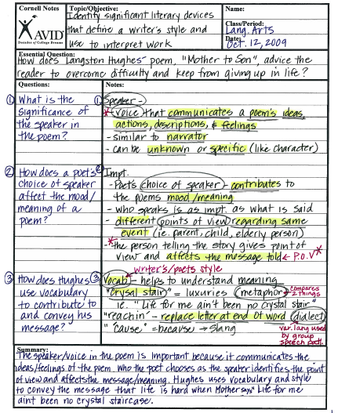
Using your notes to Study
Cover the notes on the right
Rework/Answer questions on the left
Notes:
Students should later go back and study their notes
Have students cover up the information on the right with a blank piece of paper
Rework the questions on the left
Then see if the information matches

Slide 17
Let’s Focus on your Notes
Look over your notes
  Underline/highlight important information
  Cross out unnecessary information
Meet with your Partner
  Fill in missed information
  Generate two good study question in the left column
Notes:
Here students are going to use their notes from THIS lecture on C Notes
Have students independently highlight and cross out unnecessary information
Then have students meet with their Northwest Partner in order to:
Fill in missing information from the lecture
Generate Two questions

Slide 18
Tonight’s homework
Insure you have 2 good study questions on the left
Set a timer for 3 minutes (or watch the clock), and do a Quickwrite summary answering:
  How are taking Cornell Notes different from how I have taken Notes in the past?
Take Cornell Notes in at least 2 academic classes
Notes:
Review homework, and tell students they will need this for tomorrow.

